Slide 1

Digital Portfolio
STUDENT NAME: Saranya S
REGISTER NO : 2422K0123
NMID:asbru4e2422k0123
DEPARTMENT: B.Sc (Computer Science)
COLLEGE:Texcity Arts and Science College,Coimbatore
UNIVERSITY:Bharathiyar University

Slide 2
PROJECT TITLE
Interactive portfolio website developed using HTML, CSS, and JavaScript

Slide 3
AGENDA
Objective: Create a personal portfolio to showcase skills and projects.
Overview: Interactive website built using HTML, CSS, and JavaScript.
Audience: Recruiters and collaborators.
Tech Stack: HTML, CSS, JavaScript.
Design: Responsive layout with clean UI.
Features: Project gallery, contact form, smooth navigation.
Outcome: Fully functional site with cross-device compatibility.
Conclusion: Highlights front-end development expertise.

Slide 4

PROBLEM STATEMENT
In today’s competitive IT landscape, professionals often face challenges in effectively showcasing their skills and projects. Traditional resumes lack interactivity and fail to reflect creativity or practical coding abilities

Slide 5
PROJECT OVERVIEW
This personal portfolio website was designed and developed using HTML, CSS, and JavaScript. It serves as a digital space to present my professional profile, skills, certifications, resume, and contact information.
The site features a responsive layout with smooth animations, modal popups, and a clean UI/UX. These elements ensure a user-friendly experience, allowing recruiters and clients to easily navigate and explore my work.
The portfolio effectively showcases my front-end development capabilities in an interactive format, going beyond traditional resumes to highlight creativity and real-world coding skills.

Slide 6
WHO ARE THE END USERS?
Recruiters & Hiring Managers To evaluate my skills, projects, and certifications.
Clients / Companies To contact me for freelance or job opportunities.
Peers & Developers To get inspired or collaborate on projects.
Myself To maintain a digital identity showcasing my career journey.

Slide 7
TOOLS AND TECHNIQUES
Frontend: HTML5, CSS3, JavaScript (Vanilla JS)
Design: Responsive layout, animations, modal popups
Hosting: GitHub Pages, Netlify, or Vercel
Assets: Postimages for certificates, resume, and profile images

Slide 8
PORTFOLIO DESIGN AND LAYOUT
Navigation Bar (Fixed) Smooth scrolling to all sections.
Home Section Profile photo, name, role, and tagline.
About Section A brief introduction and background.
Skills Section Interactive cards listing my skills.
Certificates & Resume Section Modal popups to view documents.
Contact Section Contact info and form for client inquiries.
Responsive Design Optimized for desktop, tablet, and mobile devices.

Slide 9
FEATURES AND FUNCTIONALITY
Responsive design with mobile-ﬁrst approach.
Modal popup for certiﬁcates and resume.
Hover animations on skills and proﬁle image.
Contact form with name, email, phone, and project details.
Fixed navigation bar with smooth scrolling.
Dark modern theme with glowing accent colors.

Slide 10
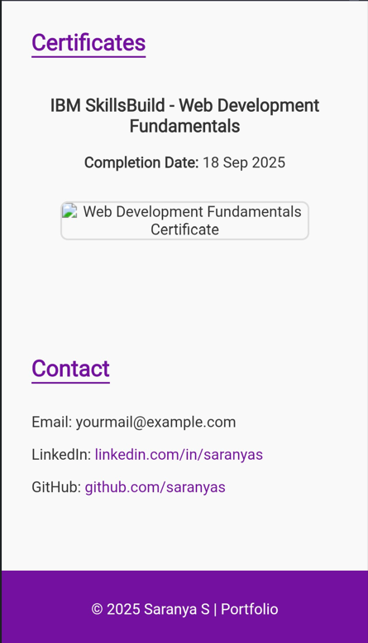
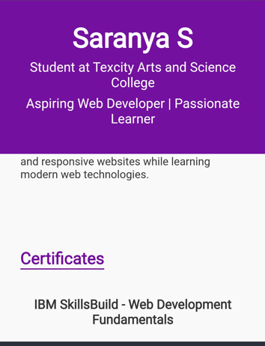
RESULTS AND SCREENSHOTS

Slide 11
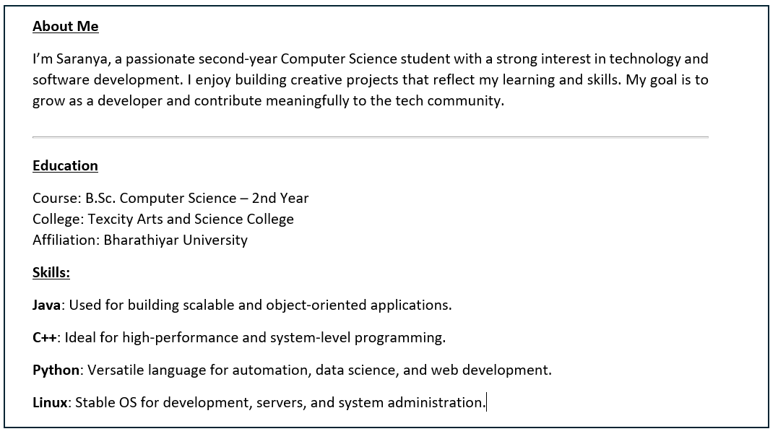
About me

Slide 12
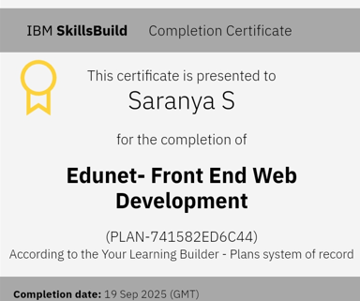
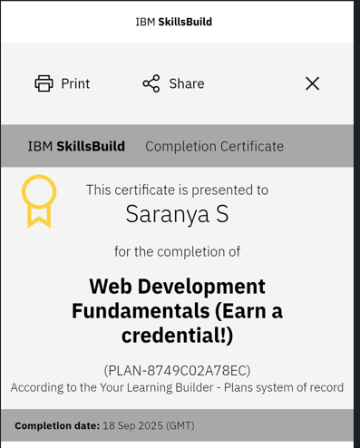
Certifications

Slide 13
CONCLUSION
Challenge & Solution
The portfolio website addresses the challenge of dynamically presenting my skills and achievements. Unlike static resumes, it offers an engaging and interactive way to showcase my capabilities.
Technology & Impact
Built using HTML, CSS, and JavaScript, the site reflects my proficiency in frontend development. It provides recruiters with a user-friendly interface to explore my profile and work.
Learning & Growth
This project enhanced my skills in UI/UX design, responsive layouts, and JavaScript interactivity, contributing significantly to my growth as a frontend developer.

Slide 14

Thank you….

